Slide 1
Image Classification Using Deep Neural Networks
Modular PyTorch Pipeline for Visual Recognition/Classification
Enes Aykuter
Bowdoin College

Slide 2
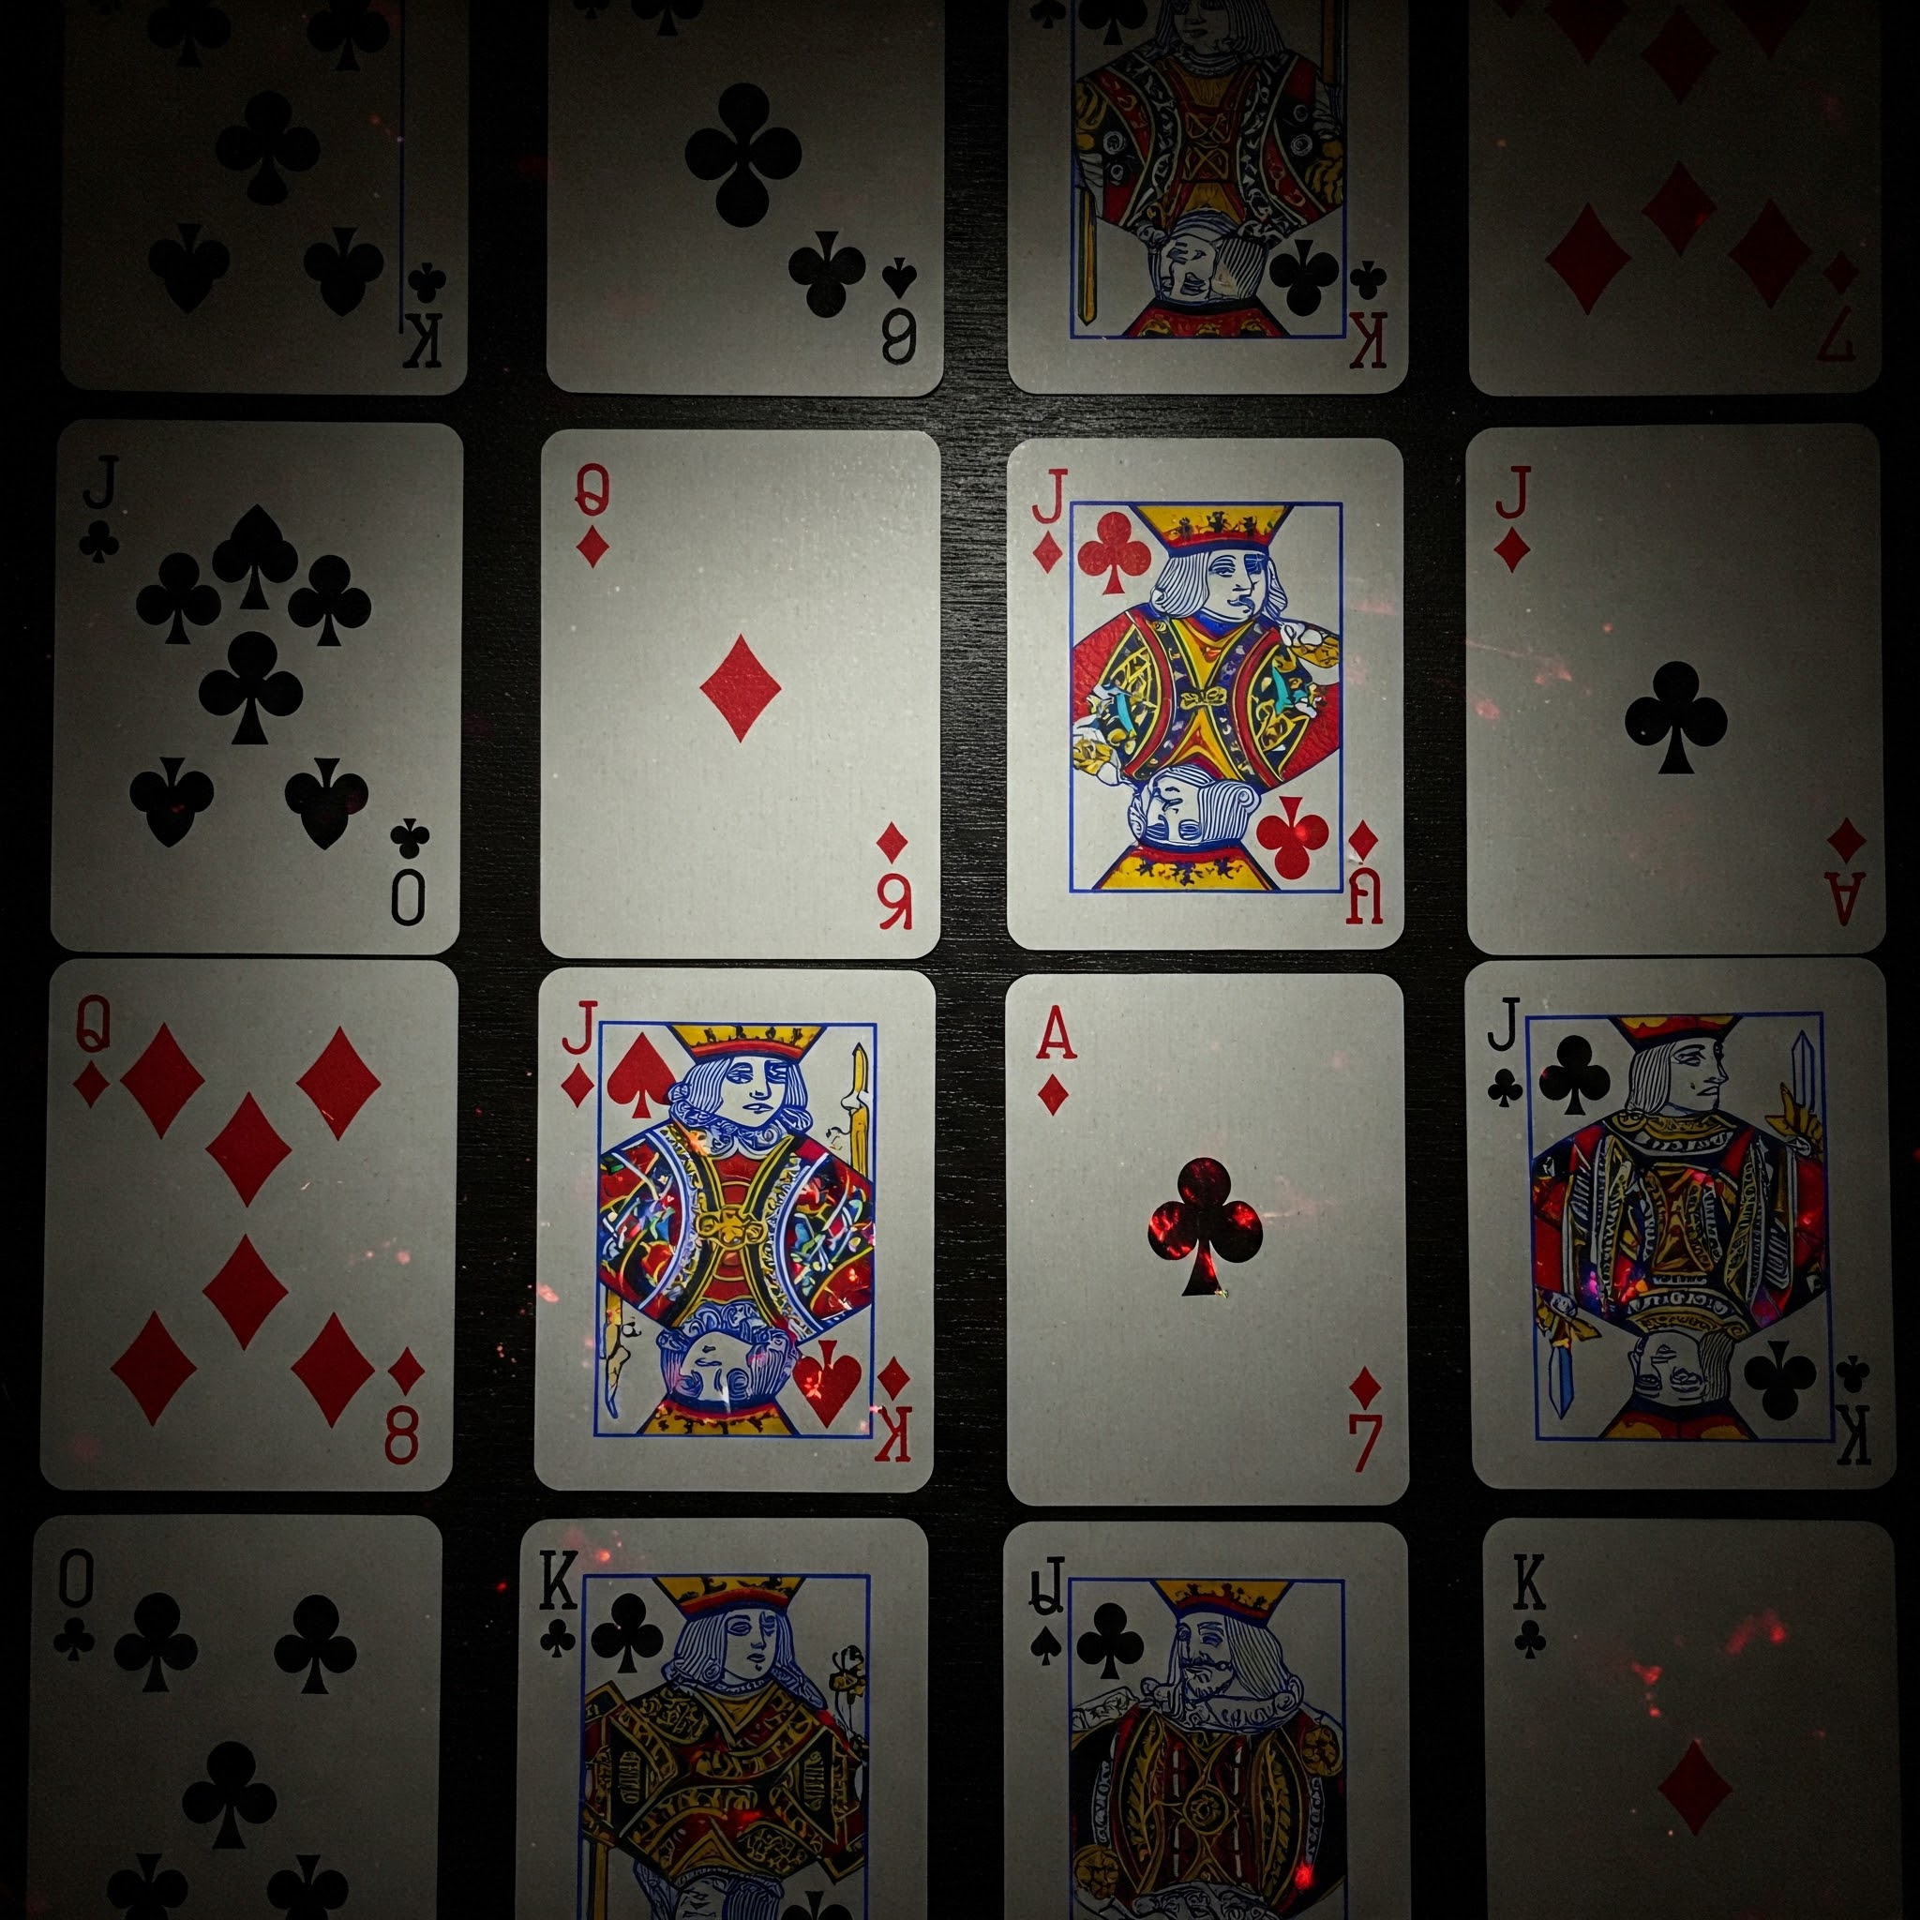
Motivation
How can we create a algorithm to distinguish between different types of playing cards?
Can neural networks be helpful for this problem??
Can we build one pipeline to classify both cards and emotions???

Slide 3

Project Overview
Built a model to distinguish 53 types of playing cards (13 ranks x 4 suits + joker)
Used a pre-trained ImageNet model and customized it with PyTorch library
Modularized* the workflow to adapt to different datasets
*reusable code for training, preprocessing, etc for different datasets.

Slide 4

PyTorch, ImageNet & timm Libraries
ImageNet:
- Large-scale dataset with 14+ million labeled images
- Pretrained model widely used in model benchmarks
timm library: - Provides Hundreds of pretrained models, including EfficientNet, ViT, ConvNeXt, etc.
- Simple API: timm.create_model(...)
- Used in this project to load EfficientNet, pretrained on ImageNet
PyTorch: - Developed by Meta (Facebook) - Widely used in both research and production

Slide 5
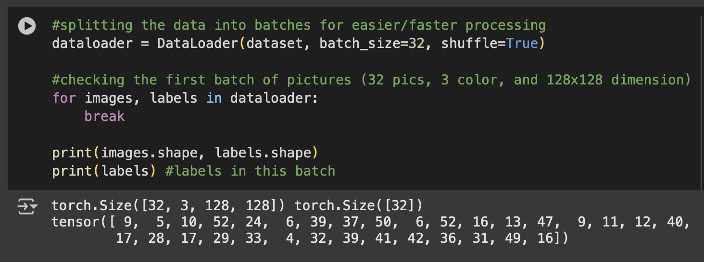
Sample Use of PyTorch
PyTorch stores data as tensors. Tensors are basically multi-dimensional matrices optimized for matrix operations often used in neural network trainings.

Slide 6
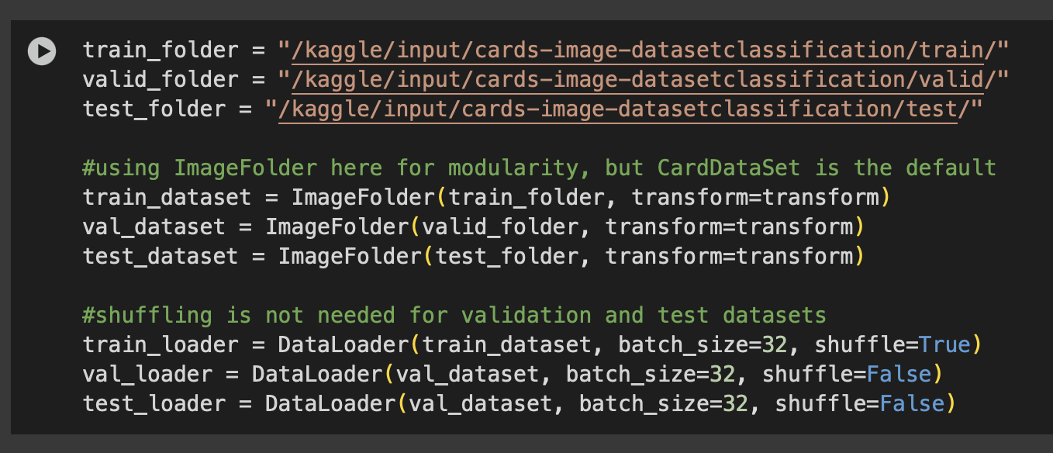
Dataset
I used ImageFolder for easy access to data and to split it into training and validation folders. I also re-scaled the images into 128x128 pixels for faster processing.
Finally, I loaded the scaled images into DataLoader* after for easier access.
*I tried to build a custom CardDataSet but found out later that DataLoader does the same thing more efficiently and more modular.

Slide 7
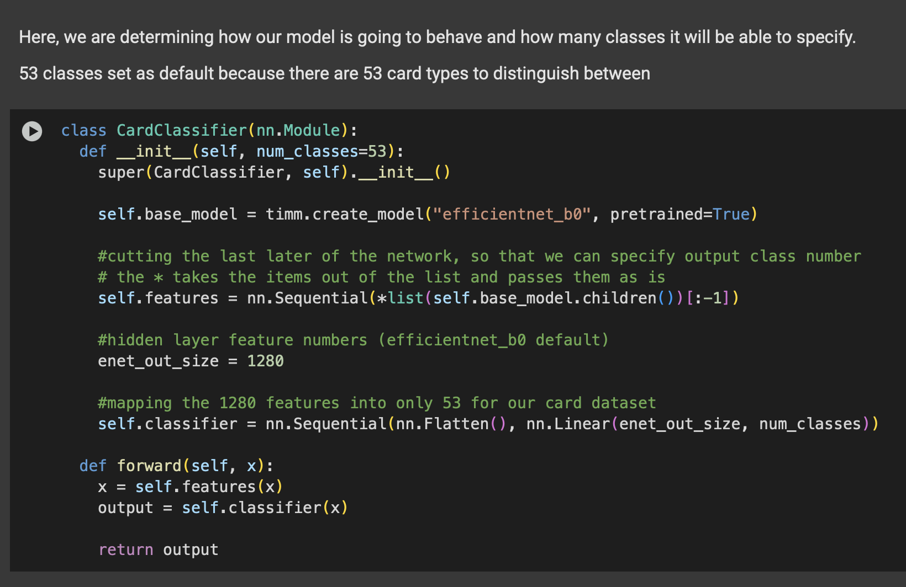
Model Training
Used the pre-trained EfficientNet as backbone
Got rid of the last layer
Mapped 1280 nodes into 53 classes for my cards (fine tuning!)

Slide 8
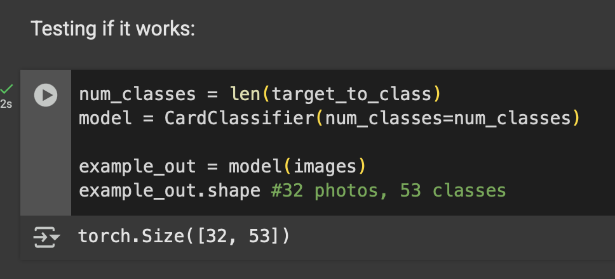
Instantiated the model and tested on a batch of 32 photos. It works!

Slide 9
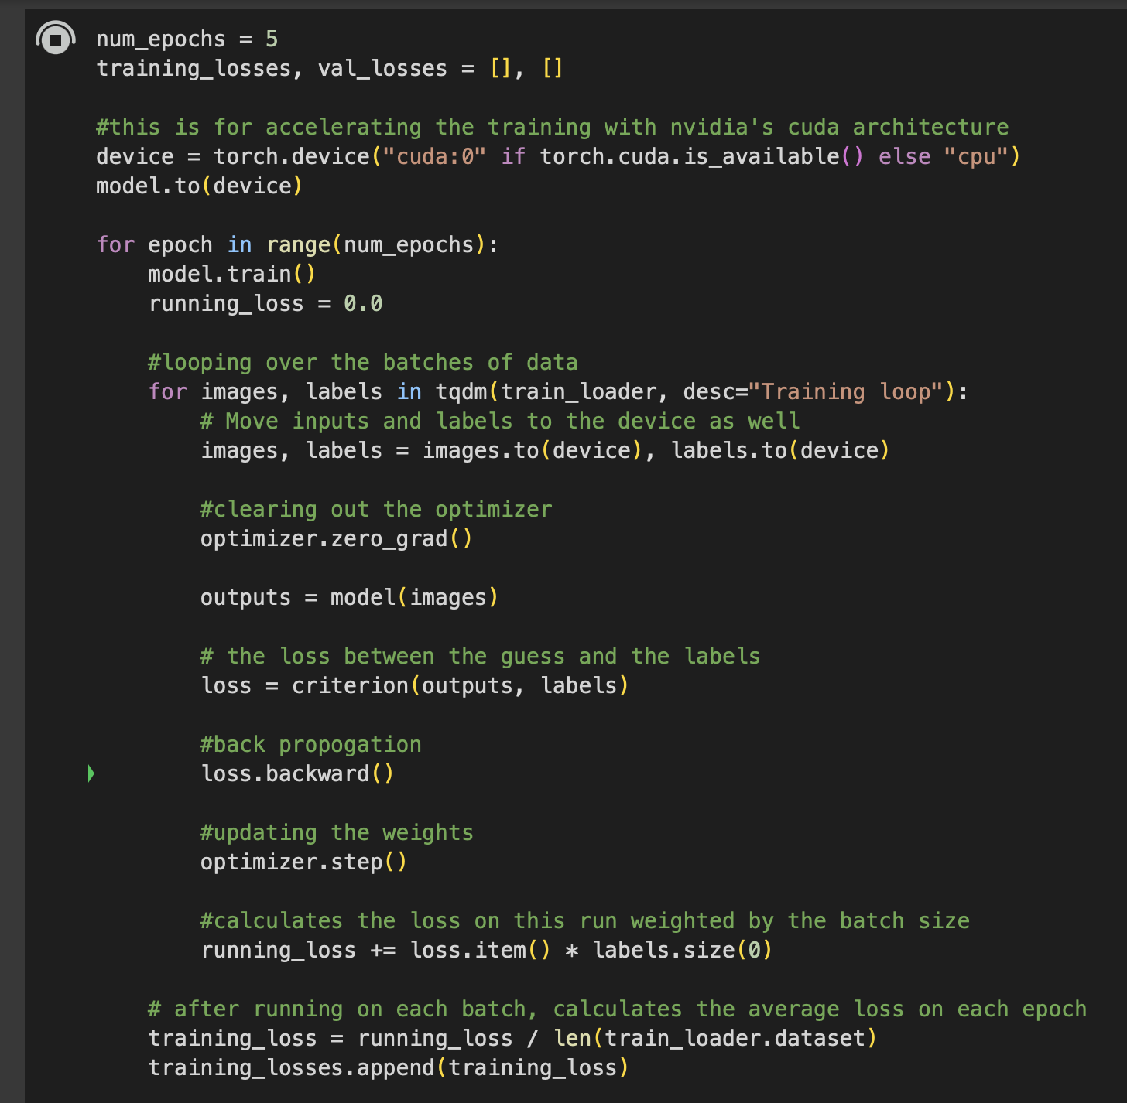
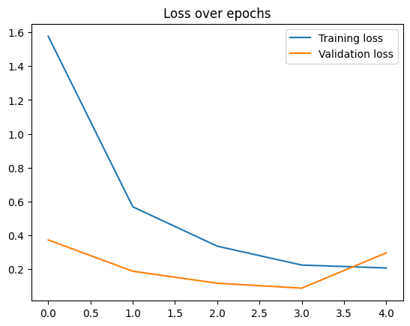
Training Loop

Slide 10
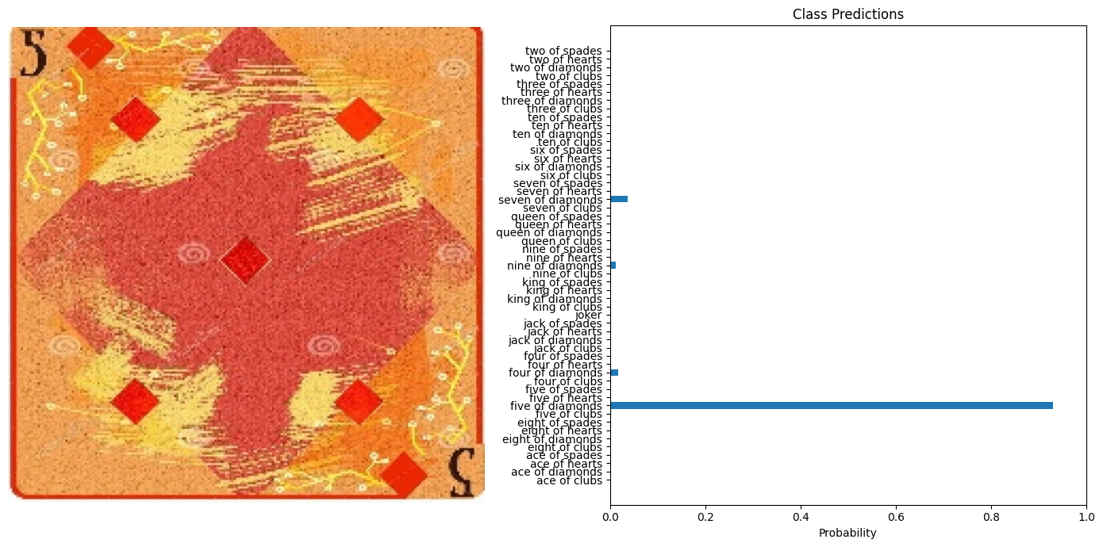
Sample Classification

Slide 11
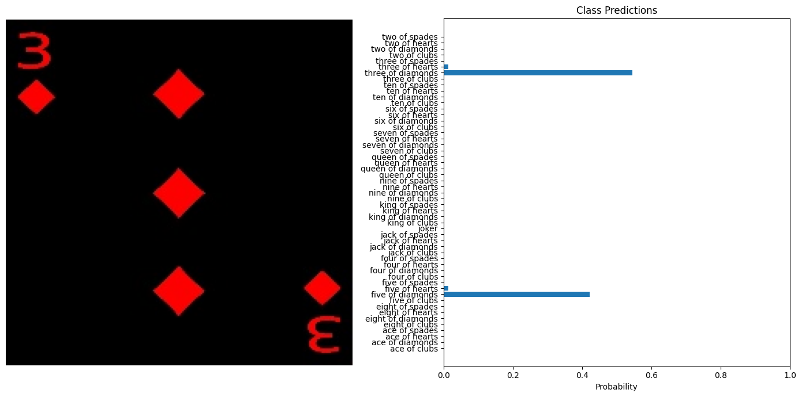
Sample Classification

Slide 12

Can we reuse this code for happy/sad images?
Yes! The workflow is pretty modular and by just changing the dataset paths and output feature numbers, we can classify happy and sad images.

Slide 13
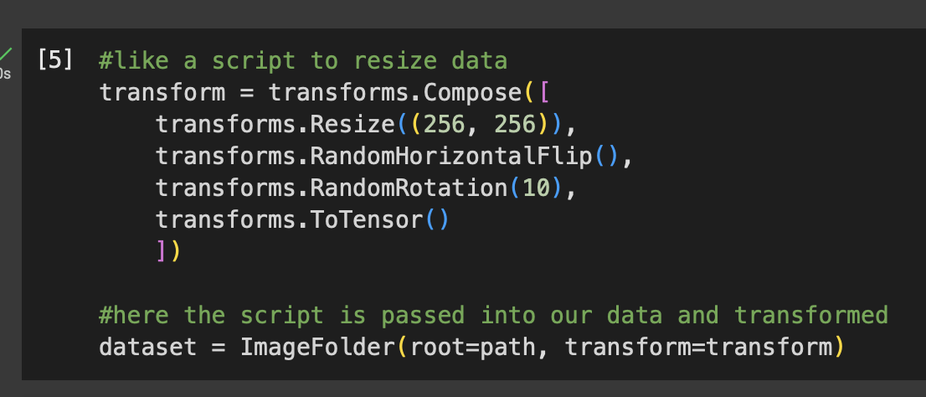
Changes I had to make
Change the transformations: - 128x128 images weren’t enough for general pattern recognition. The model was overfitting and the validation loss was constantly high.
- Changed the dimensions to 256x256 and added rotation and flipped the images for more diversity in training. -Output classes:
Playing Cards (53) → Emotion Faces (2)

Slide 14
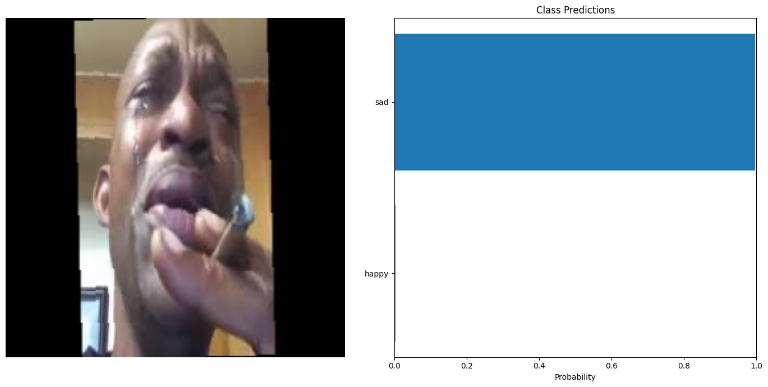

Slide 15
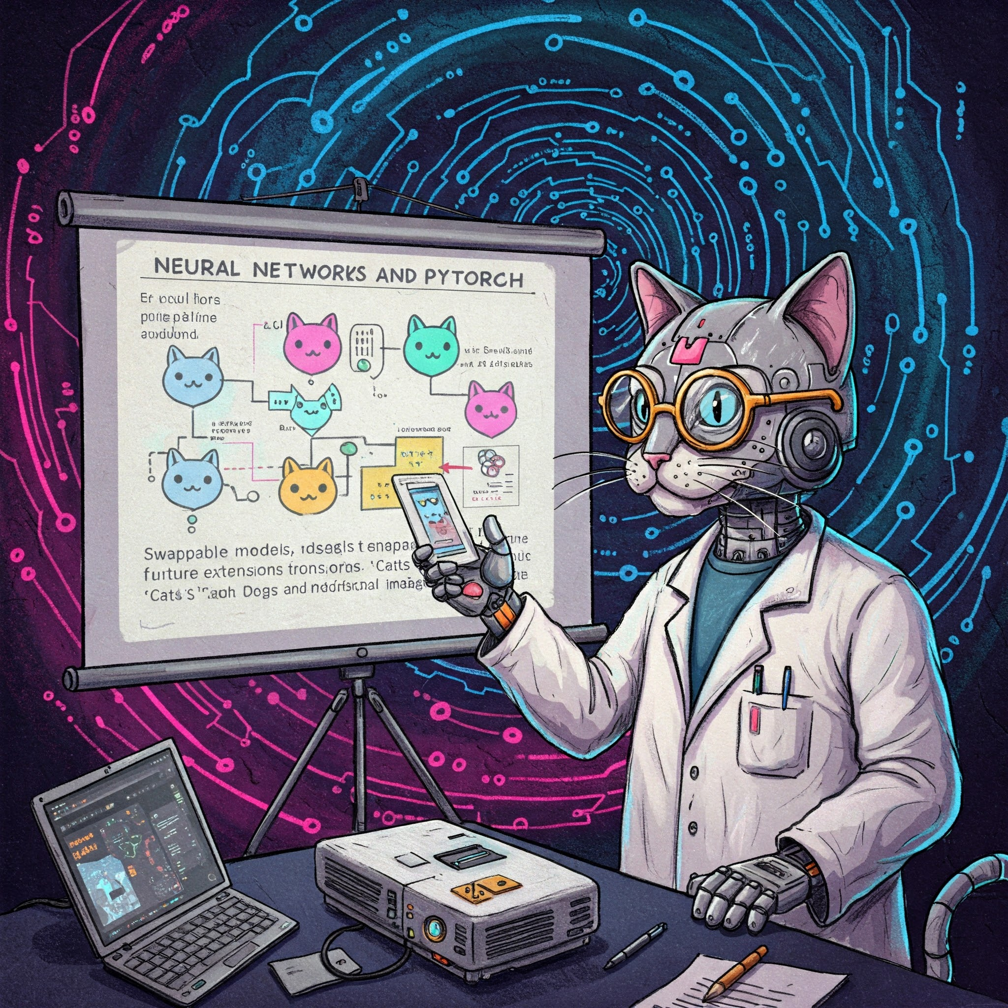
Why modularity matters?
- Same codebase → different datasets
- Swappable model, transform, dataset paths
- Makes future extensions (e.g., cats vs. dogs, medical images) trivial

Slide 16
Sources/Inspirations
https://www.kaggle.com/code/robikscube/train-your-first-pytorch-model-card-classifier
https://www.youtube.com/watch?v=tHL5STNJKag&t=1156s
https://www.kaggle.com/datasets/aravindanr22052001/emotiondetection-happy-or-sad
https://docs.pytorch.org/tutorials/
https://www.youtube.com/feed/history
https://www.youtube.com/watch?v=IC0_FRiX-sw
Thank you for listening!
Link to project: https://colab.research.google.com/drive/1ZZ-W16wohrbh22iTSDZ0AcWNC1Dfjd3g?usp=sharing
Happy/sad version: https://colab.research.google.com/drive/18vEKoUCN8sRw2i1nVOcLAkvEnm2kbSRE#scrollTo=gAPCakpfs4Zx

